Slide 1
Elementary Graph Algorithms: DFS
CLRS Chapter 22.3

Slide 2
Depth-First Search
We discuss another algorithm for exploring the nodes of a graph
Quite similar to BFS, but explores vertices in different order

Slide 3
Depth-First Search (DFS)
Another algorithm for searching a graph
Input: G(V,E) (no source vertex)
Produces a “depth-first forest” which contains every vertex in G, even if they are disconnected from one another.
Called “depth first” because it tries to increase the search tree’s depth as much as possible.

Slide 4
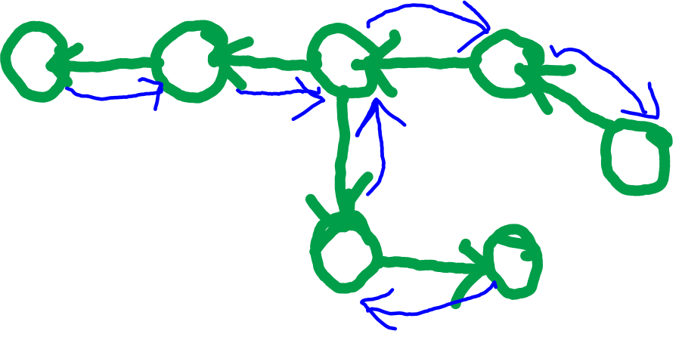
DFS Example
Start at an arbitrary node, say 3. Go as deep as possible, following undiscovered nodes. When cannot proceed, backtrack as little as possible.
Do we get different trees if we start at a different node?
7
6
1
2
3
5
4

Slide 5
Depth-First Search (DFS) Implementation
Each vertex is one of three colors: BLACK, GRAY, WHITE, similar to BFS
Initially all vertices are WHITE
Predecessors in the DFS-tree are set to NIL
If a vertex is discovered during the search then it becomes GRAY
When a vertex is discovered it is put into a Stack (implicitly)
First discovered vertex is an arbitrary source

Slide 6
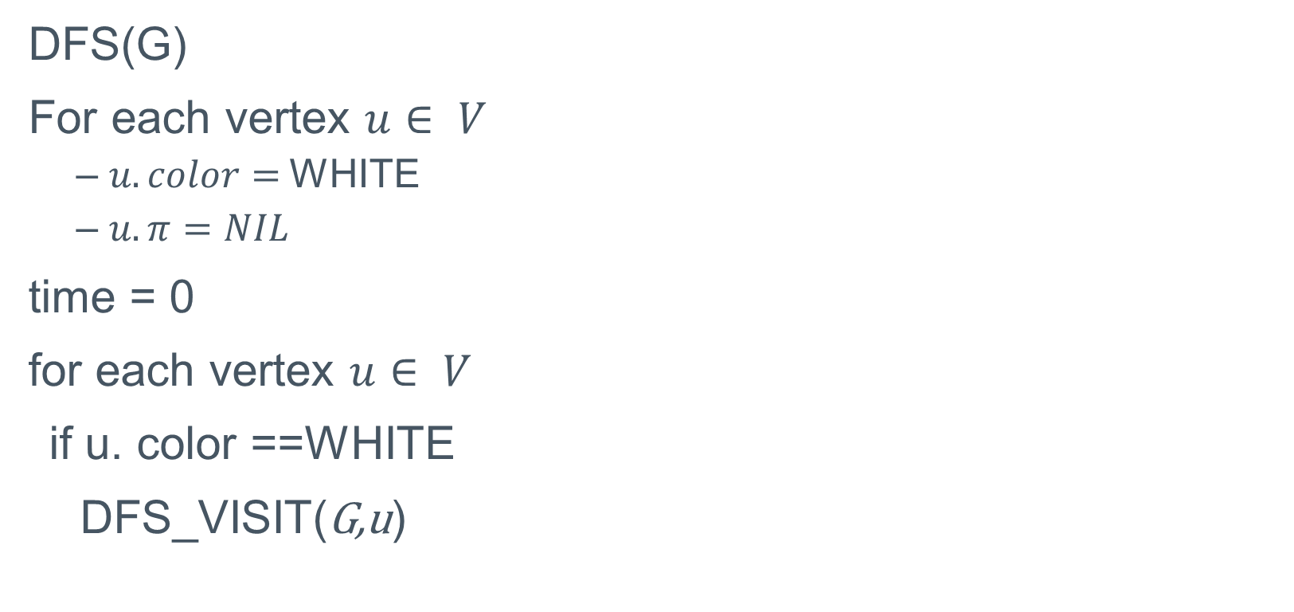
DFS: Main Body
DFS(G)
For each vertex $u∈ V$
$u.color=$WHITE
$u.π=NIL$
time = 0
for each vertex $u∈ V$
if u. color ==WHITE
DFS_VISIT(G,u)

Slide 7
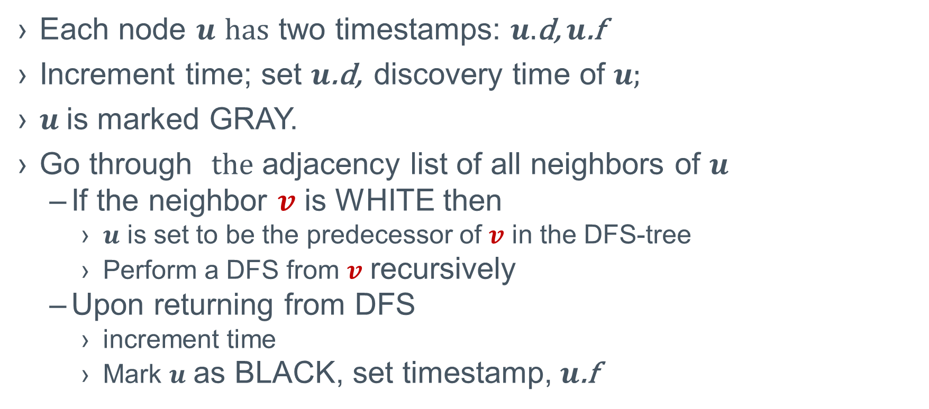
DFS: Forming individual trees
Each node $u$ has two timestamps: $u.$d, $u$.f
Increment time; set $u$.d, discovery time of $u;$
$u$is marked GRAY.
Go through the adjacency list of all neighbors of $u$
If the neighbor $v$ is WHITE then
$u$ is set to be the predecessor of $v$ in the DFS-tree
Perform a DFS from $v$ recursively
Upon returning from DFS
increment time
Mark $u$ as BLACK, set timestamp, $u$.f

Slide 8
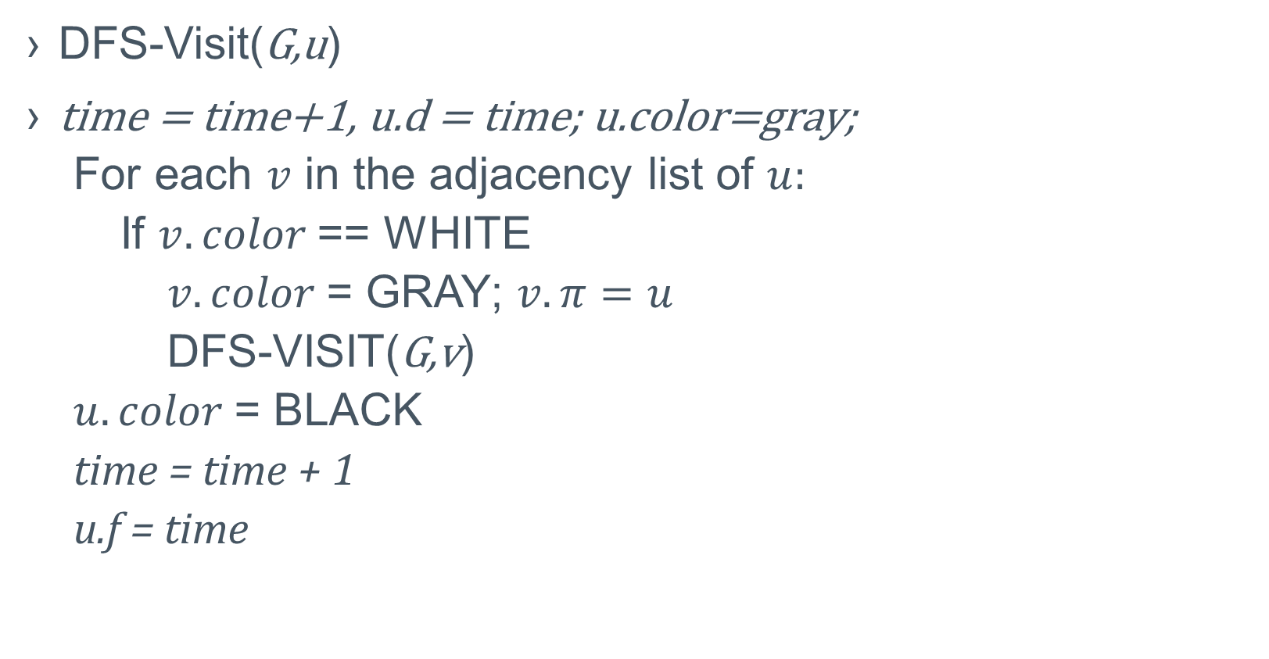
DFS continued: Main Loop
DFS-Visit(G,u)
time = time+1, u.d = time; u.color=gray;
For each $v$ in the adjacency list of $u:$
If $v.color$== WHITE
$v.color$= GRAY; $v. π=u$
DFS-VISIT(G,v)
$u.color$= BLACK
time = time + 1
u.f = time

Slide 9
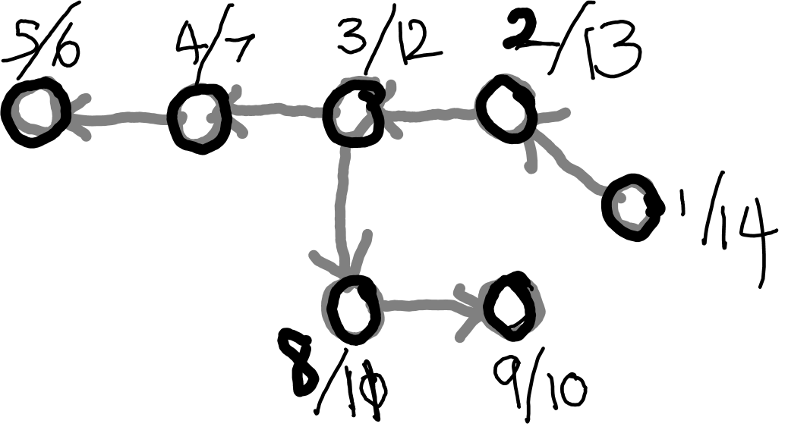
DFS: Example
7
6
1
2
3
5
4

Slide 10
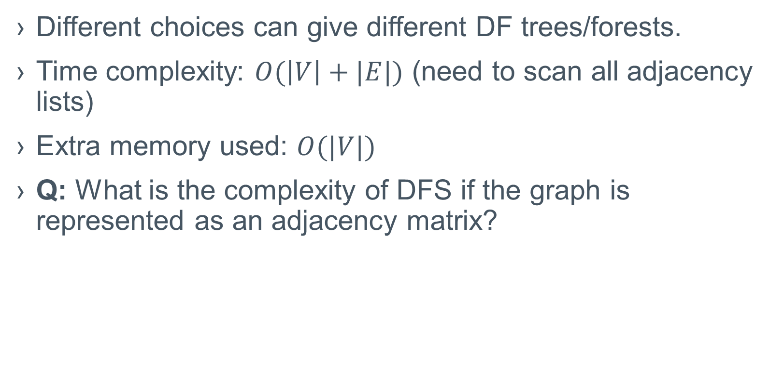
Complexity analysis
Different choices can give different DF trees/forests.
Time complexity: $O(\left|V\right|+|E|)$ (need to scan all adjacency lists)
Extra memory used: $O(|V|)$
Q: What is the complexity of DFS if the graph is represented as an adjacency matrix?

Slide 11
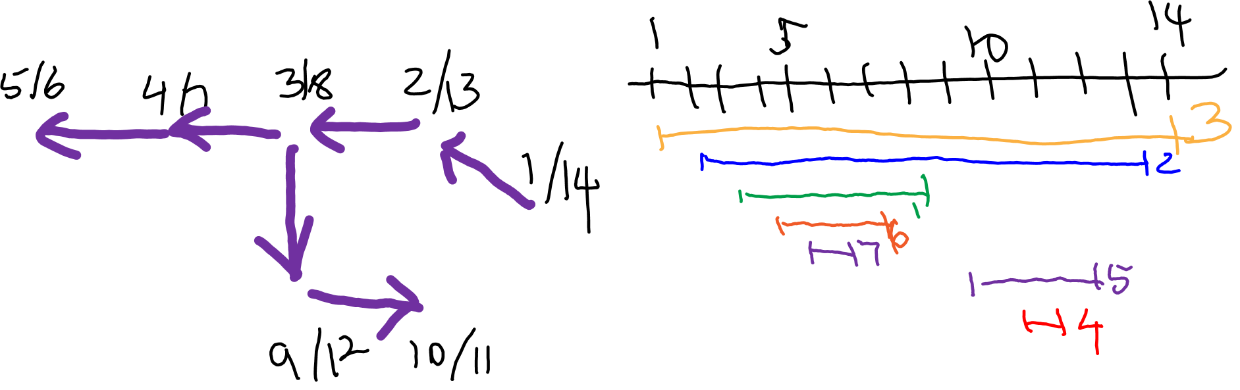
Parenthesis property of DFS
For any pair u, v, exactly one of the following is true:
Intervals [u.d, u.f] and [f.d, v.f] do not overlap, u and v are not descendants of each other in the forest.
[u.d, u.f] contained inside [v.d, v.f], u is a descendant of v (or vice versa)
7
6
1
2
3
5
4

Slide 12
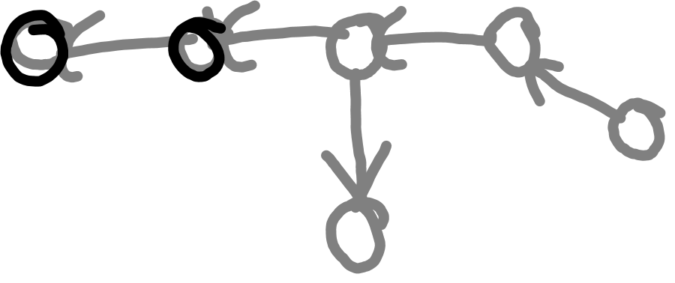
White Path Theorem
In the depth-first forest of G, v is a descendant of u if and only if, during the time that u turns GRAY (u.d), there is a fully WHITE path from u to v.
7
6
1
2
3
5
4

Slide 13
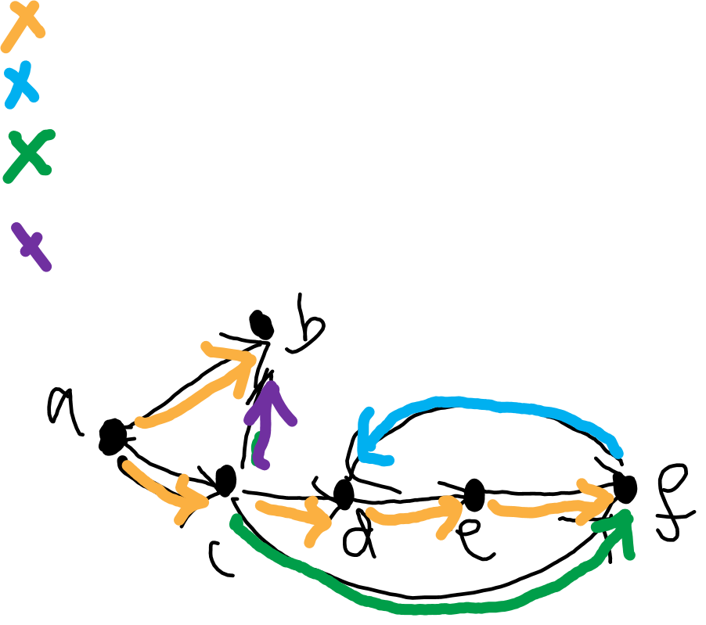
Different Types of Edges
Tree edges, formed while exploring a vertex for the first time.
Back edges connect a node to an ancestor in the DF tree
Forward edges are nontree edges connecting a node to a descendant
Cross edges are everything else.

Slide 14
Different Types of Edges
Tree edges, formed while exploring a vertex for the first time.
Back edges connect a node to an ancestor in the DF tree
Forward edges are nontree edges connecting a node to a descendant
Cross edges are everything else.
Theorem: Undirected graphs have only tree or back edges.

